Slide 1
Non-Overlapping Magisteria in Genome Biology: Bridging the Gap Between Biology and Genetics
John B. Cole
PAG 32 Cattle/Swine Workshop | January 11, 2025

Slide 2
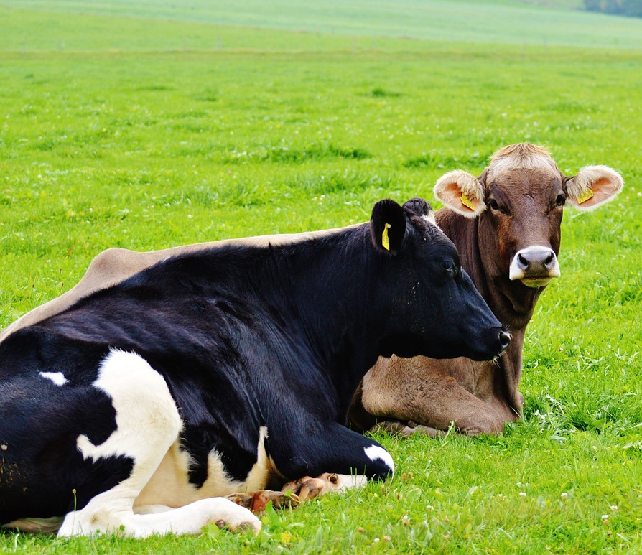
Topics
Current landscape
What is a trait?
What is a QTL?
What can we learn from correlations?
How does genetic selection change animals?
How might we integrate the two domains?
Final thoughts

Slide 3

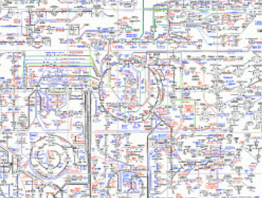
Current landscape
Genetics
(Quantitative)
Genetics
(Molecular)
PREDICTION
MECHANISMS
P = G + E
?
?
P = G + E + M
P = G + E + M + “B”
Black-box models are fine, accurate prediction is the goal
Przytycka and Andrews (2010)
Black-box models are discouraged, detailed understanding is the goal

Slide 4

Genetic improvement in 1 slide
ΔG = genetic gain each year
reliability = how certain we are about estimates of genetic merit (genomics ⬆)
selection intensity = how selective we are when mating animals (management can ⬆)
genetic variance = variation in the population due to genetics (we can’t really change this…or can we?)
generation interval = time between generations (genomics ⬇)

Slide 5
What is a trait?
Anything we care enough about to measure
  In practice, phenotypes of current or future economic importance
  For research, anything representing physiological states
The field of phenomics now includes both trait definition and recording (Koltes et al., 2019; Cole et al., 2020)
  There are so many traits (e.g., https://bioportal.bioontology.org/ontologies/VT)
  Standardization remains a problem (e.g., ICAR guidelines)

Slide 6
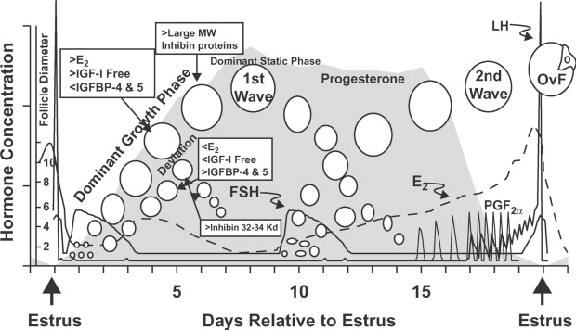
Do we properly define traits?
Some phenotypes are simple, others are not
  Milk production or number of piglets farrowed are easy to measure
  Others are very challenging –
  what is “fertility”?
Needs may change over time –
imprecise definitions can still
be useful

Slide 7
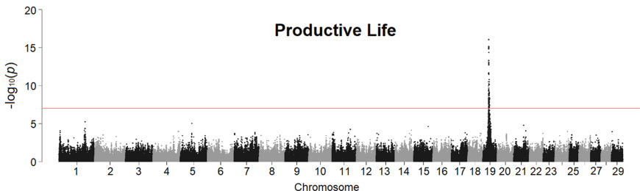
What is a QTL?
Li et al. (2021; https://doi.org/10.3168/jds.2020-18766)
A gene which has “a major impact on traits of economic importance” (Kinghorn et al., 2000)
A locus which explains a large proportion of the variance in a quantitative trait, ~30% (vaguely remembered…)
GWAS results exceeding a level of genome-wide significance (e.g., Li et al., 2021, https://doi.org/10.3168/jds.2020-18766)
A change in fold-expression (e.g., Wang et al., 2024, https://doi.org/10.1038/s41588-024-01896-3)

Slide 8
Why do we care about definitions?
If we’re going to use genetic selection to change the population then we need to know what we’re doing
Consider fertility – what are we changing with selection?
  Ovulation rate / calving rate / litter size
  Return to cyclicity after parturition with clear expression of estrus
  Ability to conceive on service and remain pregnant
  Capacity to give birth to healthy offspring without difficulty
  What about the male component of fertility?

Slide 9
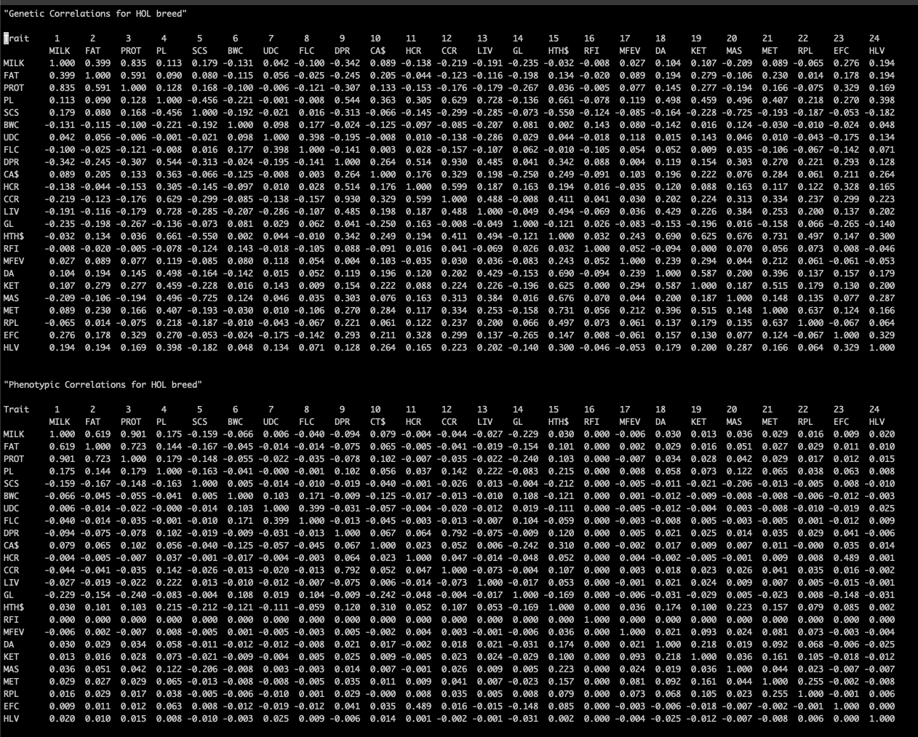
What can we learn from correlations?
Correlations are good in a statistical sense
They’re more complicated from a biological perspective
Breeders assume pleiotropy and epistasis are rare
  …that’s probably not true.
USDA-ARS-AGIL-AIP (2021; https://www.ars.usda.gov/arsuserfiles/ 80420530/publications/arr/nm8%20supplemental%20table_correlations_2021.txt)

Slide 10
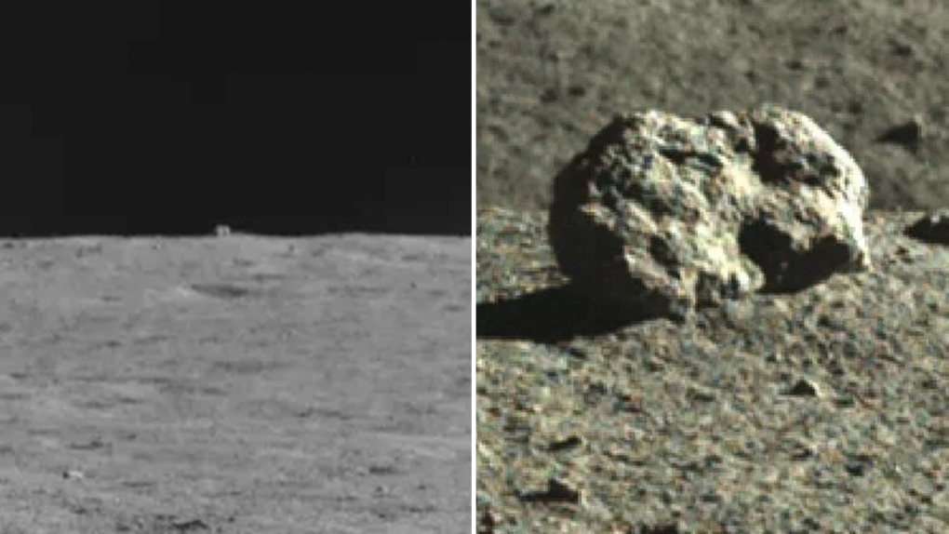
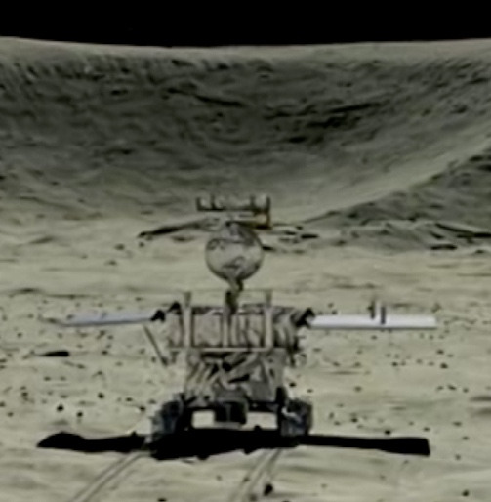
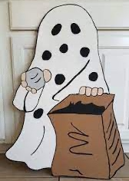
Patterns are easy, meaning is hard

Slide 11
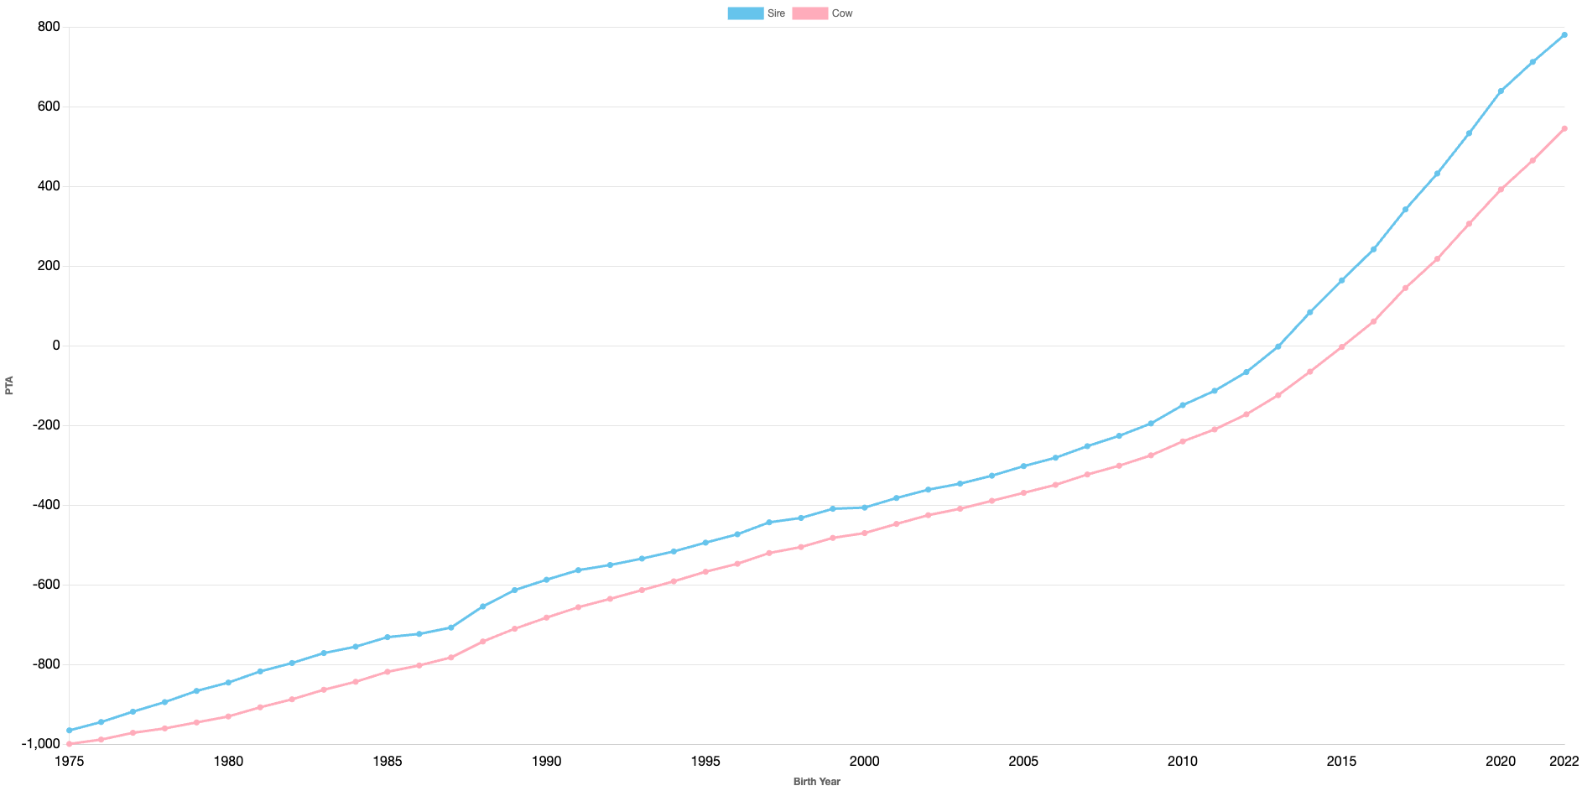
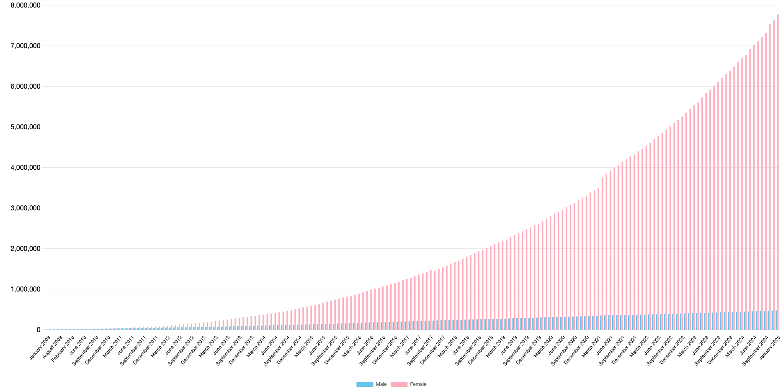
Dairy cow genetics are improving quickly
Animal Model
Genomic Selection
CDCB (https://webconnect.uscdcb.com/#/summary-stats/genetic-trend)

Slide 12
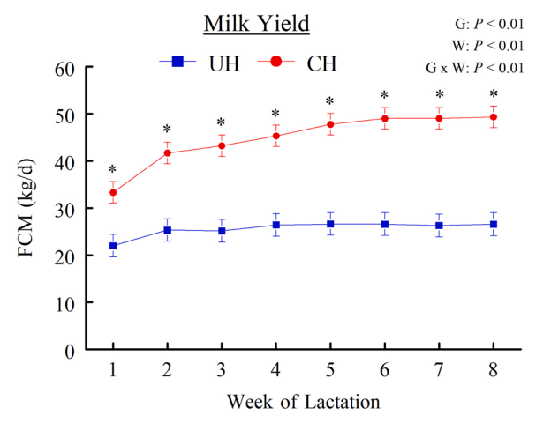
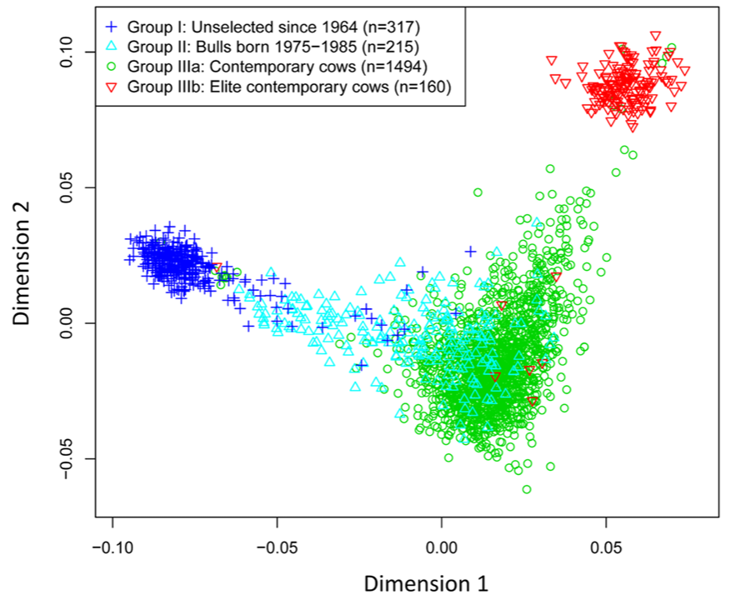
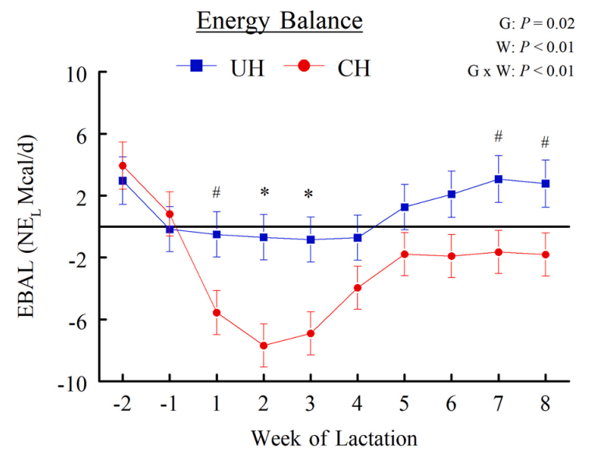
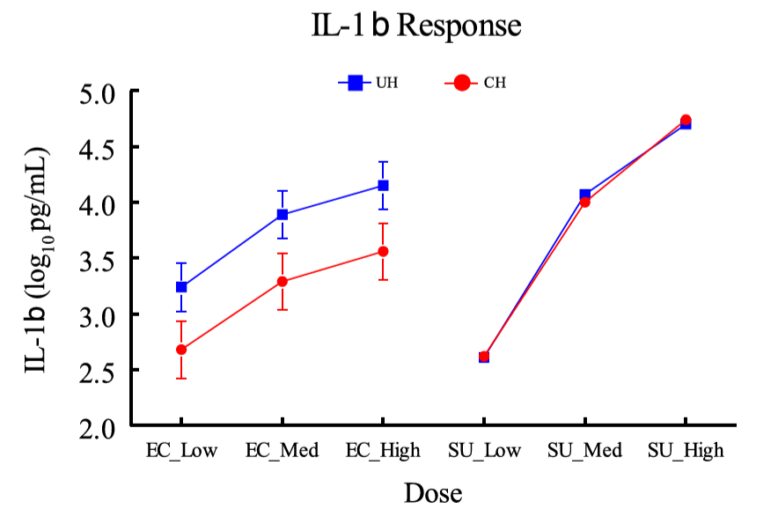
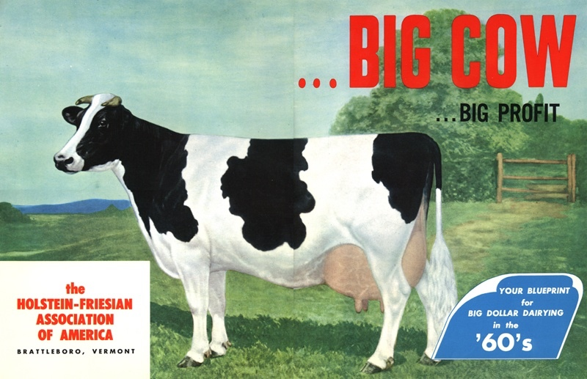
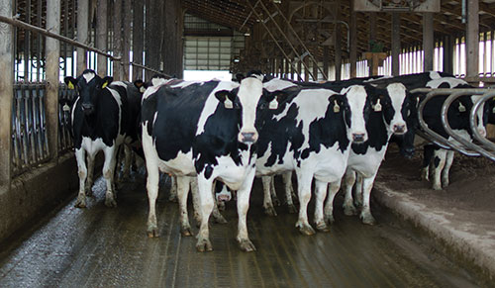
How is dairy cow biology changing?
Brink et al. (2022; https://doi.org/10.1016/j.vetimm.2022.110463)
Ma et al. (2019; https://doi.org/10.1186/s12864-019-5459-x)
U.S. Ideal Holstein – 1960s
U.S. Ideal Holstein – 2020s?
Brink et al. (2023; https://doi.org/10.1016/j.vetimm.2023.110573)

Slide 13
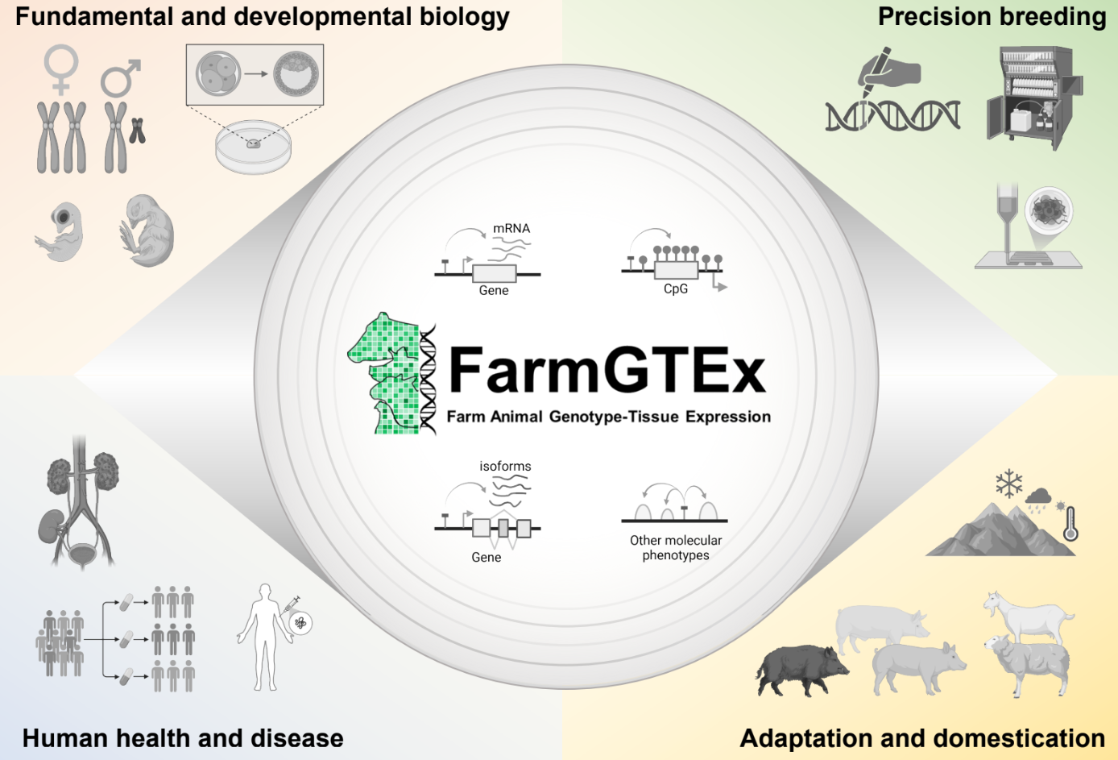
Future landscape
Genetics
(Molecular)
Genetics
(Quantitative)
MECHANISMS
PREDICTION
P = G + E
P = G + E + M
P = G + E + M + “B”
Black-box models are fine, accurate prediction is the goal
Przytycka and Andrews (2010)
Black-box models are discouraged, detailed understanding is the goal

Slide 14
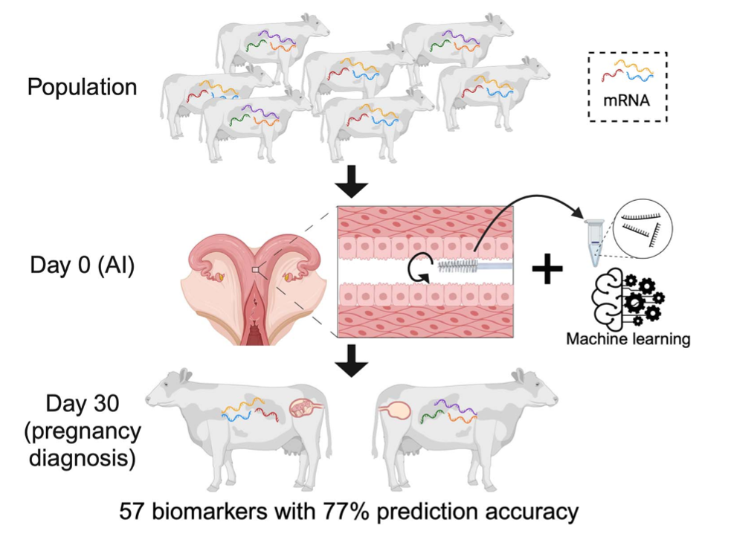
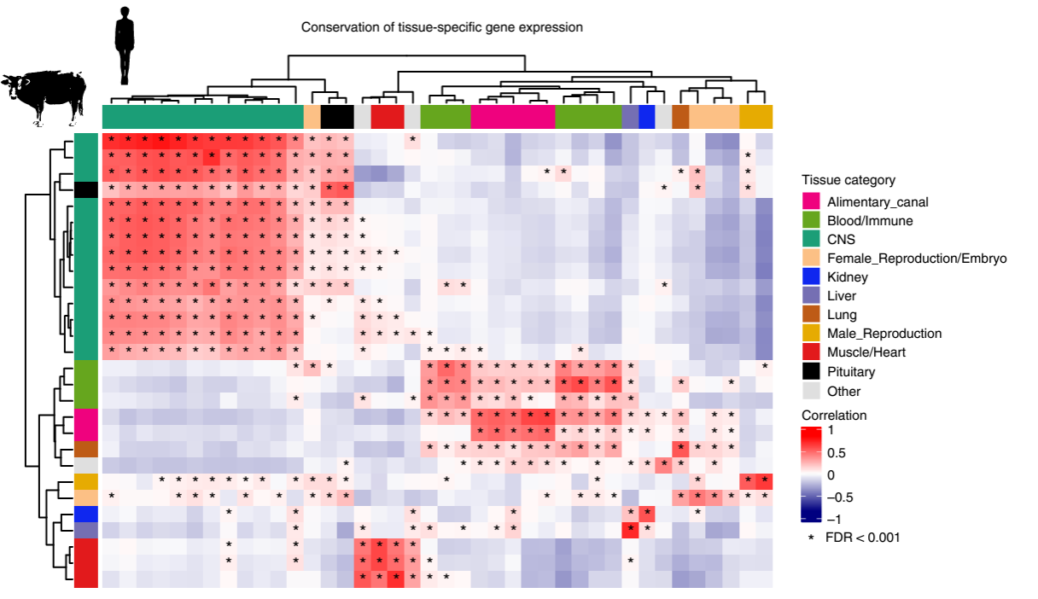
What might we achieve together?
Hoorn et al. (2024; https://doi.org/10.1093/biolre/ioae052)
Liu et al. (2022; https://doi.org/10.1038/s41588-022-01153-5)

Slide 15
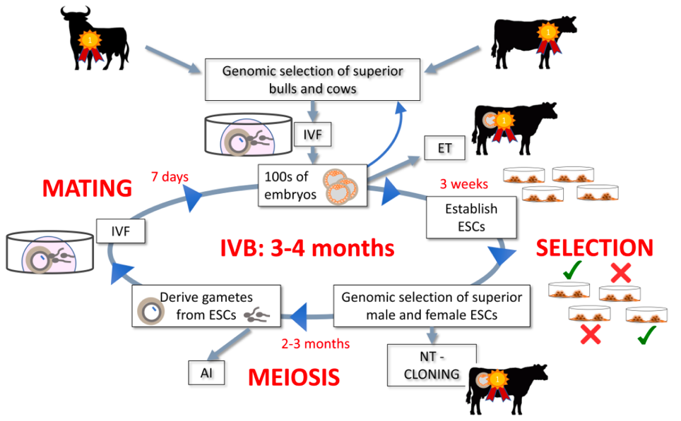
How fast can change actually go?
Stem cells can be taken from embryos, transformed into sperm and eggs, and used to create the next generation of embryos
This increases the rate of genetic gain
Clones are created after several generations of selection

Slide 16
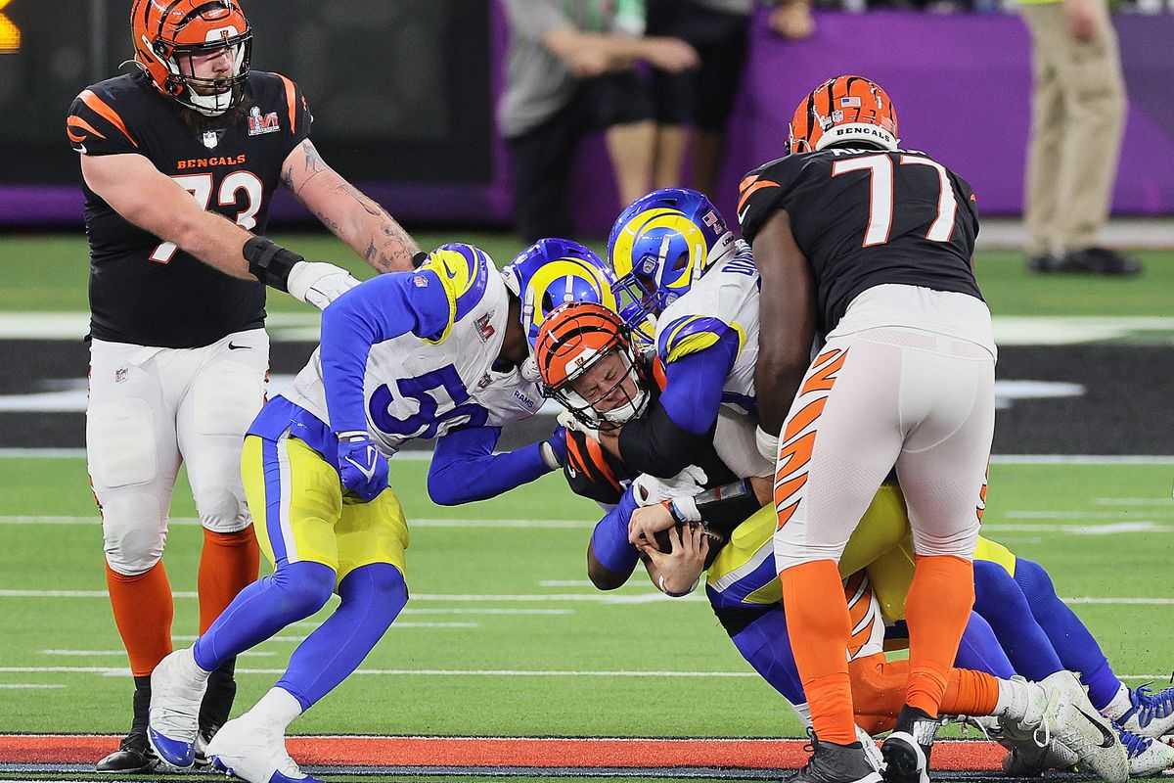
What can one species learn from others?

Slide 17
What can one species teach others?
There are lessons to be learned, but they’re
very context-dependent
Methodology is [relatively] easy for groups
to collaborate on
What can we learn about biology with direct comparisons?
  Ruminants versus monogastric species
  Singleton versus multiple births
  Microbiomes
  Automated phenotyping/data collection and standardization

Slide 18
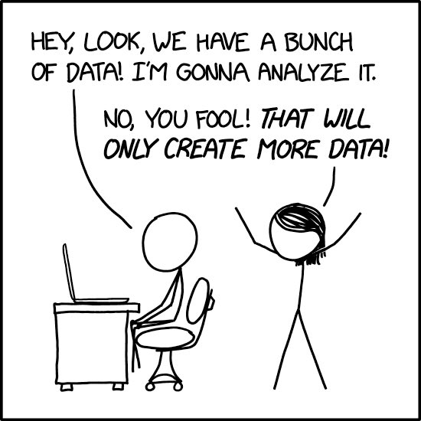
Final thoughts
We have now the tools to dissect biology at
a level impossible 25 years ago
  Large animal research is very expensive and funding is limited
Collaboration of molecular biologists and animal breeders is needed to build models to predict biological outcomes
If I was 18 again I’d study developmental biology
Sorry about the title, too much Dylan

Slide 19
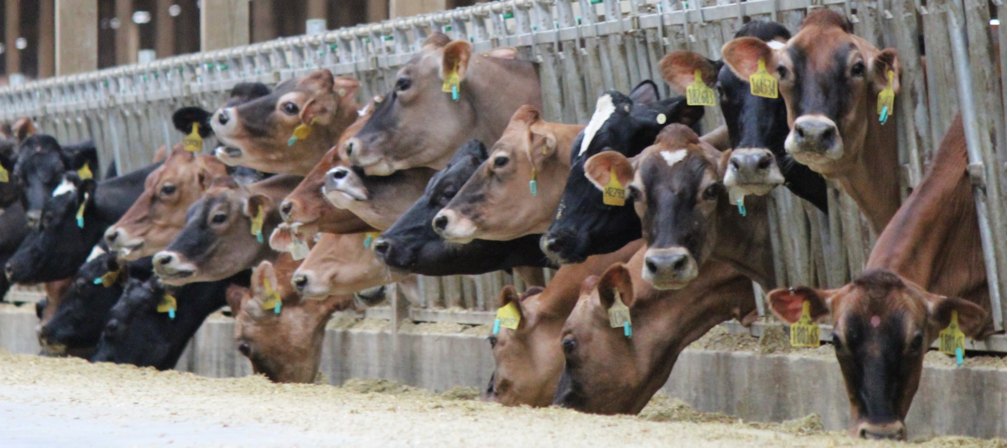
Questions?

